Slide 1
TRIRIGA Reports
Commonly Used Reports for Real Estate/Asset Management

Slide 2
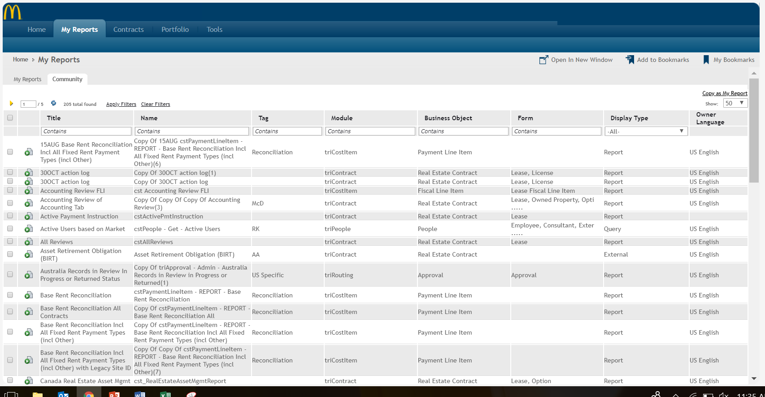
How to Run a Community Report
Select My Reports from the main TRIRIGA Dashboard
Click on the Community sub-tab to see a list of over 200 reports
Scroll through and click on any of the reports to find more information
If you can’t find what you are looking for, request a report through the Service Café
1
1
2
2
3
4

Slide 3
Helpful Reports for TRIRIGA Accounting Functions
If You Want to See | Report to Use
Critical Accounting tab information | Accounting Review of Accounting Tab
Cash payments for a certain period and base rent | ​Base Rent Reconciliation Incl Fixed Rent with Legacy Site ID
Pending or posted journals for a certain period | Filter on JE in Title field within Community Reports
Upcoming renewal options | Critical Dates Report
​​Which leases will expire in the next 18/24/60 months | ​Expiration Report

